Slide 1
IBM Rational Rhapsody Advanced Systems Training v7.5
Extending the Environment with Profiles

Slide 2
Objectives
In this module you will learn:
  The basic SysML extension mechanisms
  How to create your own profiles
This module also contains an introduction to using profiles to create a domain specific language.

Slide 3
IBM Rational Rhapsody Advanced Systems Training v7.5
Extension Mechanisms – Basic Concepts

Slide 4
Overview – SysML extension mechanisms
Three primary lightweight extension mechanisms exist in the SysML language:
  Tags
  Stereotypes
  Constraints
A Profile is a coherent set of these three things:
  Specializes the language for a vertical market domain, business environment, or company.

Slide 5

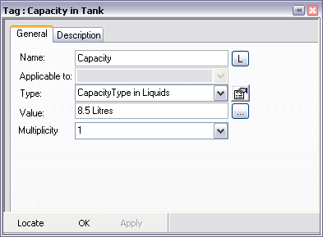

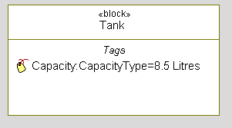
Tags
Tags are user-defined properties used to hold and convey additional meaning.
  Can be shown in a compartment.

Slide 6
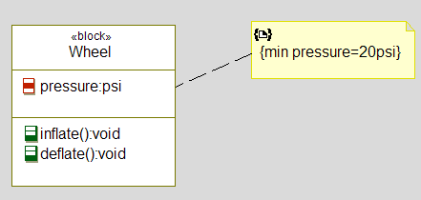
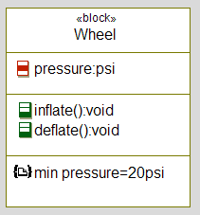
Constraints
A Constraint is an extension mechanism:
  Represents a user-defined well-formedness rule.
    For example, {deadline = 100us}
  May be shown in note form attached to an element.
  May also be shown in a compartment.

Slide 7
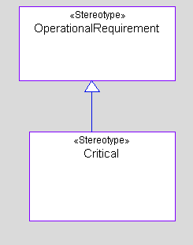
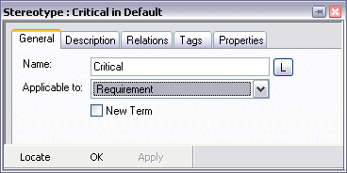

Stereotypes
A stereotyped element becomes a special kind of model element:
  Stereotypes are shown in the browser as separate elements.
  Stereotypes can inherit from other stereotypes.
  Stereotypes can be shown / modeled on diagrams.
  When applied to an element type, the stereotype is selectable only for that element type.
  Stereotypes may be used to apply properties / formatting

Slide 8
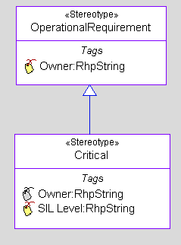
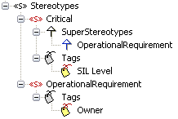
Stereotypes and Tags
Tags can be associated with Stereotypes:
Inherited tags are shown in grey

Slide 9
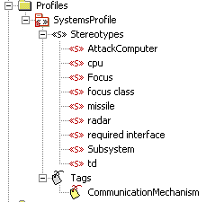
Profiles
A Profile is a package that contains model elements that have been customized for a specific domain or purpose
A Profile can be converted to a Package and vice versa:
  A Profile, like a Package, can hold most model elements
Profiles typically define:
  Tags
  Stereotypes
  Rhapsody properties in a similar
  way to a site.prp
  Rhapsody color/line/font formats

Slide 10
Profiles as modeling guide
A Profile can contain a model library holding domain specific elements and usage examples.
  Profiles can constrain what you are allowed to model.
    For example only certain relationships may be allowed between certain elements.
It is expected that very few in an organization define Profiles.
  But more use relevant Profiles.
Like Packages, Profiles can own any element.
  When designing Profiles you can add diagrams that describe the purpose and usage of the Profile.

Slide 11
IBM Rational Rhapsody Advanced Systems Training v7.5
Creating Profiles

Slide 12
Open a model
Launch Rational Rhapsody.
From the menu:
  File > Open
Open the SimpleProfile model.

Slide 13
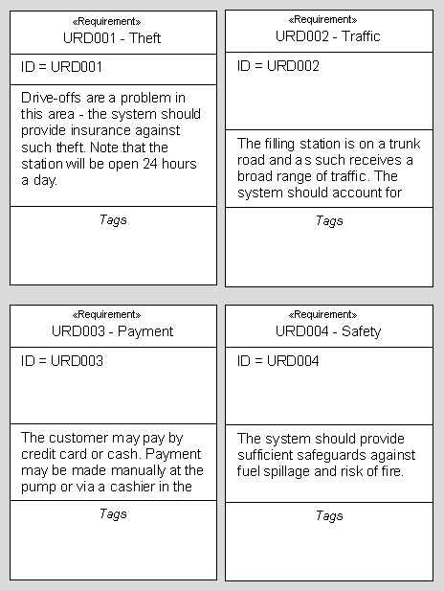
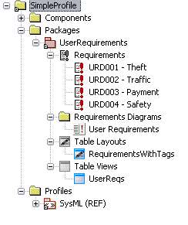
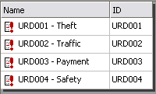
Observe the model
The model contains
  A Package of Requirements.
  A Requirement Diagram.
  A Table Layout and a Table View.

Slide 14
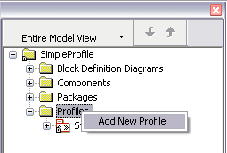
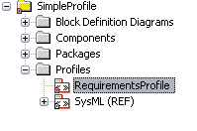
Creating a Profile
Right-click the Profiles category and add a new profile
  You could also right-click the project and select Add New > UML > Profile
Name the Profile RequirementsProfile

Slide 15
Tags
Tags may be:
  Local
    Only this model element has the extra information.
    The Tag is defined on that model element.
  Global
    All model elements of this type have the extra information.
    The Tag is defined in a Profile.
    The Tag definition must contain:
      The model element type which this Tag applies to.
      The type of the information (for example string, enumeration)
      The default value (optional)

Slide 16

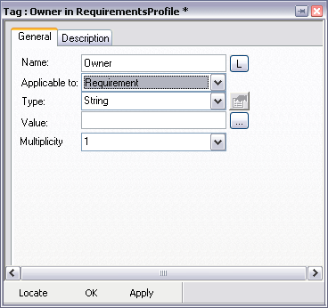

Defining global Tags
Right-click the Profile and select Add New > UML > Tag
Modify its features as shown below
  Name: Owner
  Applicable To: Requirement
  Leave the Type as String

Slide 17
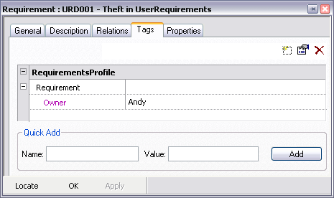
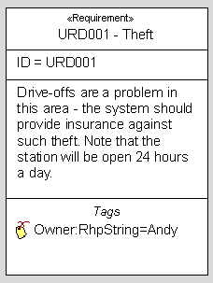
Modify Requirements
In the Browser, right-click Requirement URD001 and select > Features
  In the Features View, select the Tags tab.
  In the right-hand field, type Andy as the owner of the Requirement.
  Note the change on the User Requirements Requirements diagram

Slide 18
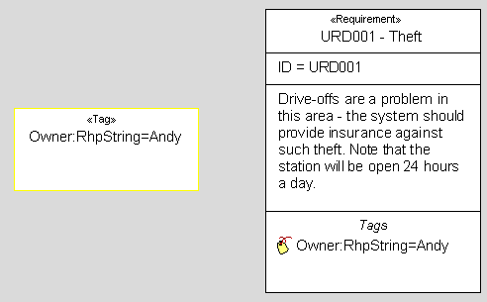
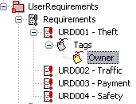
Tags on diagrams (1)
Once the Tag has a value it appears underneath the Requirement element
  Drag this Tag onto the Requirements diagram

Slide 19
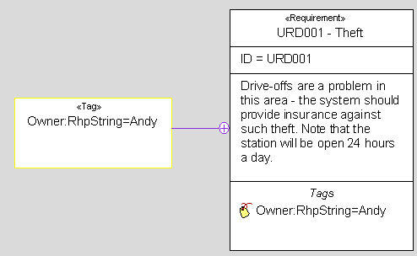
Tags on diagrams (2)
From the toolbar select:
  Layout > Complete Relations > All
Namespace Containment

Slide 20

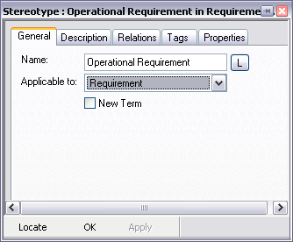
Defining Stereotypes
Right-click the RequirementsProfile and select:
  Add New > UML > Stereotype.
  Name it Operational Requirement.
  Make it Applicable To :- Requirement

Slide 21
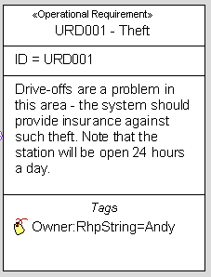
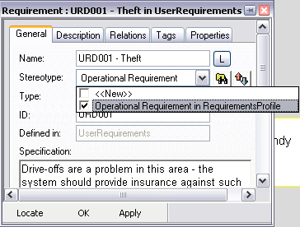
Applying Stereotypes
In the Features View for the Requirement URD001:
  General Tab
  Select Operational Requirement in the Stereotype combo-box

Slide 22
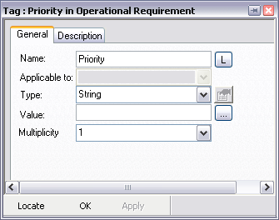

Associating Tags with Stereotypes
In the Profile:
  Right-click the Operational Requirement Stereotype and:
  Add New > UML > Tag
  Modify its features as shown below:
    Name: Priority
    Type: String
  Note that the Applicable to: field is unavailable – it is inherited from the stereotype.

Slide 23
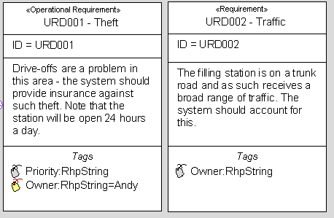
Associated Tags
Note that only those Requirements stereotyped <<Operational Requirement>> have the associated Tags.

Slide 24
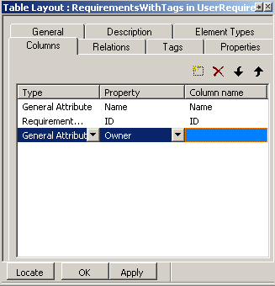

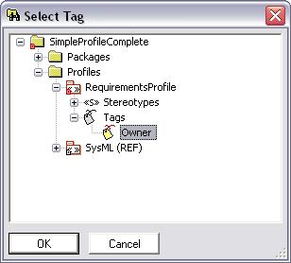
Tags in Table Views (1)
Modify the RequirementsWithTags Table Layout
  Add a column for the Owner Tag

Slide 25

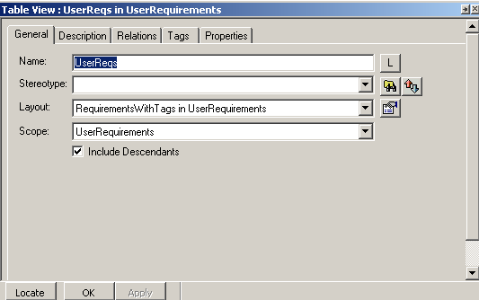
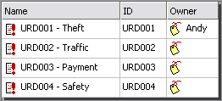
Tags in Table Views (2)
Double-click the UserReqs Table View to open it.
Open the Features view for the table and set the scope to the UserRequirements package.
Check that the layout is correctly set.

Slide 26
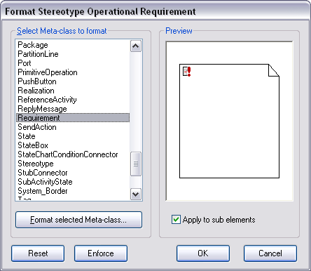
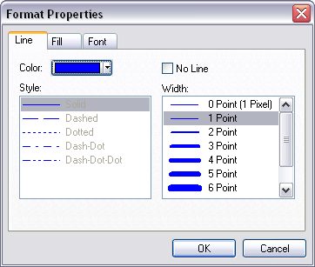
Applying styles using Stereotypes
In the Profile, right-click the Operational Requirement Stereotype and select Format.
  Using the formatting dialog, change the line color for Requirements to blue:

Slide 27
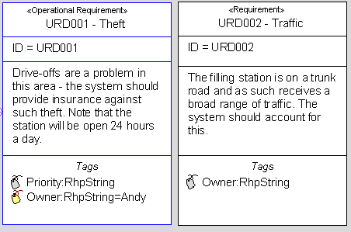
Applied formatting
Only Requirements that are stereotyped Operational Requirement get their line colors changed to blue:

Slide 28

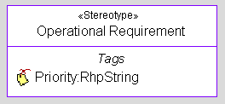
Stereotype modeling
Add a new Block Definition Diagram to the Profile
  Name it Profile Stereotypes
  Drag on the Operational Requirement Stereotype

Slide 29
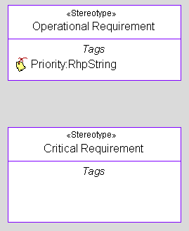
Create a new Stereoype
In the Profile, create a new Stereotype.
  Name: Critical Requirement.
  Applicable To: Requirements.
Drag the new Stereotype onto the diagram

Slide 30
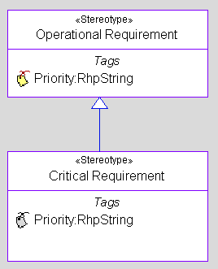
Stereotype Inheritance
Select the Inheritance tool.
  Draw an inheritance relationship from the Critical Requirement to the Operational Requirement
  Note that the Critical Requirement Stereotype inherits the Priority Tag
    Inherited Tags are shown in gray

Slide 31
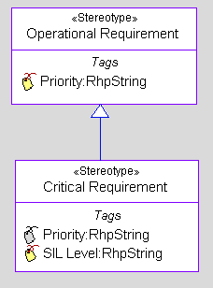
Stereotype extension
Add a new tag in Features>Tags to the Critical Requirement Stereotype:
  Name: SIL Level
  Type: String

Slide 32
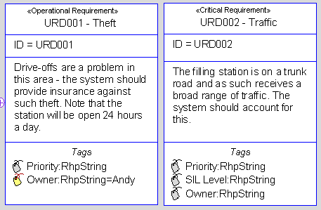
Applying Stereotypes
Apply the Critical Requirement Stereotype to Requirement URD002 by opening the Features dialog for the URD002 requirement
Note that it gets:
  Global Requirement Tags (Owner)
  Inherited Tags from Operational Requirement (Priority)
  Critical Requirement Tags (SIL Level)
  Any Inherited Formatting
    This can be further overridden

Slide 33

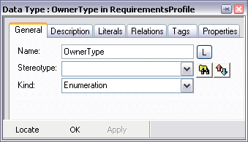
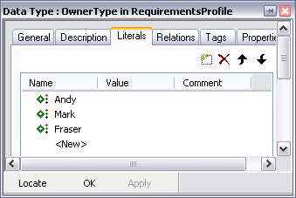
Creating user-defined types
Add a new data type to the Profile:
  Select Add New > Blocks > DataType.
  Name it OwnerType.
  Set the Kind to Enumeration.
    When the kind is set to enumeration, then a new tab appears allowing entry of the literals.
    Enter the literals shown below – Andy, Mark, Fraser

Slide 34
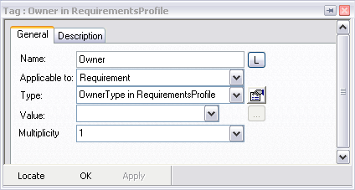

Applying user-defined types
Modify the Owner tag to use the new DataType.

Slide 35
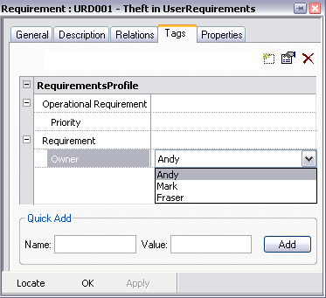
Using user-defined types
In the Features for Requirement URD001
  On the Tags Tab
  Change the Owner to Mark
  The value for the tag on each Requirement is a drop-down selection.

Slide 36
Reusing Profiles
Since a Profile is just a Special Kind Of Package – it can be reused by multiple projects
  Drag and drop between open projects
  Select File > Add to Model.
A Profile can be automatically added to a new project either as a copy or a reference in the site.prp file
  Search properties for AutoCopied or AutoReferences
  Search Factory.prp for AutoCopied or AutoReferences

Slide 37
IBM Rational Rhapsody Advanced Systems Training v7.5
Creating Domain Specific Languages

Slide 38
Objectives
Define a domain specific language in which:
  A System is made up of:
    Systems and or
    Equipment
  Equipment can contain other Equipment

Slide 39
Open a model
Launch Rhapsody.
From the menu:
  File > Open
Open the DSL model.

Slide 40
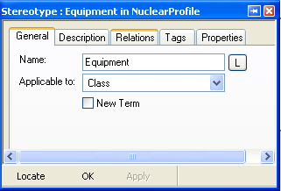
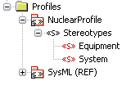
Observe the model - Profile
Note that a Profile already exists.
  Two new Stereotypes.
  Both applicable to ‘Class’.
    New Stereotypes are always applied to the base UML metatype.
    Blocks are in fact Stereotypes applicable to Class

Slide 41
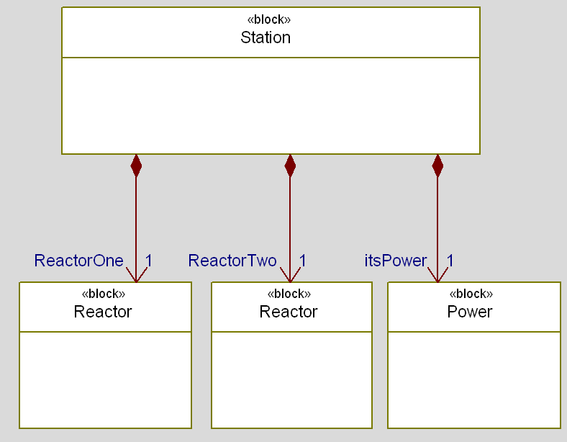
Observe the model - architecture
Note that a simple architectural model has been created using Blocks.
  Stereotypes have not yet been applied.

Slide 42
New term Stereotypes
When working in a specific domain, the usage of the terminology and notation of this domain can produce both accurate and more readable applications.
  A Domain Specific Language (DSL) defines its own model elements.
  A user-created model element is called a term.
    A term is a new kind of element.
    A term is based on an out-of-box metaclass and behaves like its base metaclass.

Slide 43
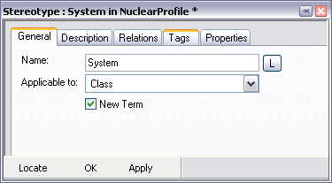
Creating new terms
In the Features for the System Stereotype:
  Check New Term.
  Click Apply.
Do the same for the Equipment Stereotype.

Slide 44
Applying new terms (1)
Now you have defined new terms you can use them in the model.
  Currently your model contains Blocks
  In the new DSL you do not want to model with Blocks – rather you want to model using Systems and Equipments
  You can use the Add New mechanism to add these directly into the Browser.
  If you have existing model elements that have the same base type then you can convert them.
  For example:
    A Block could be converted into a System or an Equipment.
    A System could be converted into a Block or Equipment.

Slide 45
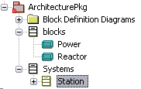
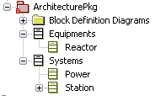
Applying new terms (2)
In the Browser, right-click the Station and select:
  Change To > System
  Note the new category in the Browser.
  In the same way:
    Change Reactor into an Equipment
    Change Power into a System
All changed
Station Block ‘changed to’ a System

Slide 46
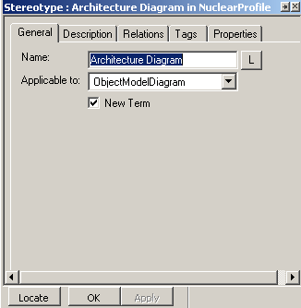
Defining new diagrams
New diagrams can be created and their toolbars controlled.
  This is in fact how the SysML Profile works.
    A Requirements Diagram is a new term based on an existing diagram type – the Object Model Diagram.
You will now create your own new Architecture Diagram diagram type:
  Add a new Stereotype to the Profile
    Name: Architecture Diagram
    Applicable To: Object Model Diagram
      This is the base diagram for BDD and Requirement Diagram
    Make it a new term

Slide 47
Diagram toolbars
Now it is possible to add new Architecture Diagrams to the model.
  However they will have the default drawing toolbar – the one that an Object Model Diagram has.
  You will modify the New Term to constrain the drawing tools that are available on an Architecture Diagram.
  The drawing toolbar can contain base elements (for example: Class) or new terms (for example: Block, Equipment)

Slide 48
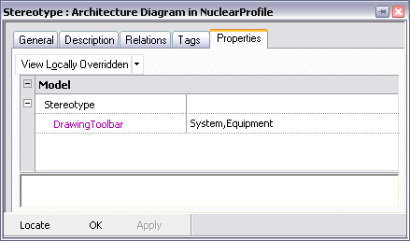
Modify the drawing toolbar property
In the Features View for the Stereotype:
  Modify the property: Model:Stereotype:DrawingToolbar
  This is a comma separated list of items to appear on the toolbar.
    Set the property as shown below.
    This means that the only tools that will appear on the drawing toolbar for an Architecture Diagram are System and Equipment

Slide 49
Close and open
If new term diagrams are created, the model must be closed and re-opened for them to take effect.
  Save the model.
  Close the model.
  Open the model.

Slide 50

Add a new Architecture Diagram
Right-click the Architecture Package and select:
  Add New > Nuclear Profile > Architecture Diagram
  Note the diagram toolbar
  The default icons used are the ones for the base metaclass
    In this case – Class
  These icons may be changed using properties

Slide 51




Constraining the model
Properties may be changed to constrain the way in which users build their models.
  Modify the properties (view all) of the System Stereotype:
  Modify the properties of the Equipment Stereotype:

Slide 52
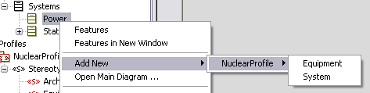
Adding model elements
In the Browser, right-click the Power System and select > Add New
  Note that the only options are the ones previously entered into the Aggregates property of the Stereotype
  This allows Profile builders to enforce a particular modeling strategy on their users.
    Improves model consistency / correctness.
    For example you could use the Profile to prevent modelers from creating a model where a power supply had a nuclear reactor inside it.

Slide 53

Project Stereotypes
Create a new NuclearModel Stereotype:

Slide 54
Further work
This has been a brief introduction to domain specific modeling with Rhapsody profiles.
For more examples see the installed profiles
  SysML
  DoDAF
  MoDAF
  Net Centric
  Autosar
  Testing Profile

